Slide 1

DATA INTELLIGENCE BOOTCADEMY
Alexandra LAW, John LEE, Mena LIU [Team 1]

Slide 2
Overview of Capstone Project
Criteria
Outperforms HSI
Volatility < HSI (Standard deviation)
Asset allocation
• Equity + Fixed Income + Cash
• Multiple regions
Backtesting period
• Since MPF launch
Considerations
Extreme market situations
e.g. 2008 Financial Crisis
Retirement needs
• De-risking mechanism
Risk tolerance
Management fee
• Gross return / net return

Slide 3
Agenda - MPF schemes in focus of your team - Expected data analysis findings from the Capstone project - Data collection method - Data profile of each MPF scheme - Data quality and handling - Analytical-based table(s) (ABT) - Modeling discovery

Slide 4



MPF Schemes in Focus
1
2
3
AMTD
China Life
Principal
AMTD MPF Scheme
- 16 Funds
China Life MPF Master Trust Scheme
- 9 Funds
MPF Scheme Series 800
-11 Funds

Slide 5
1
Expected Analysis Finding

Slide 6
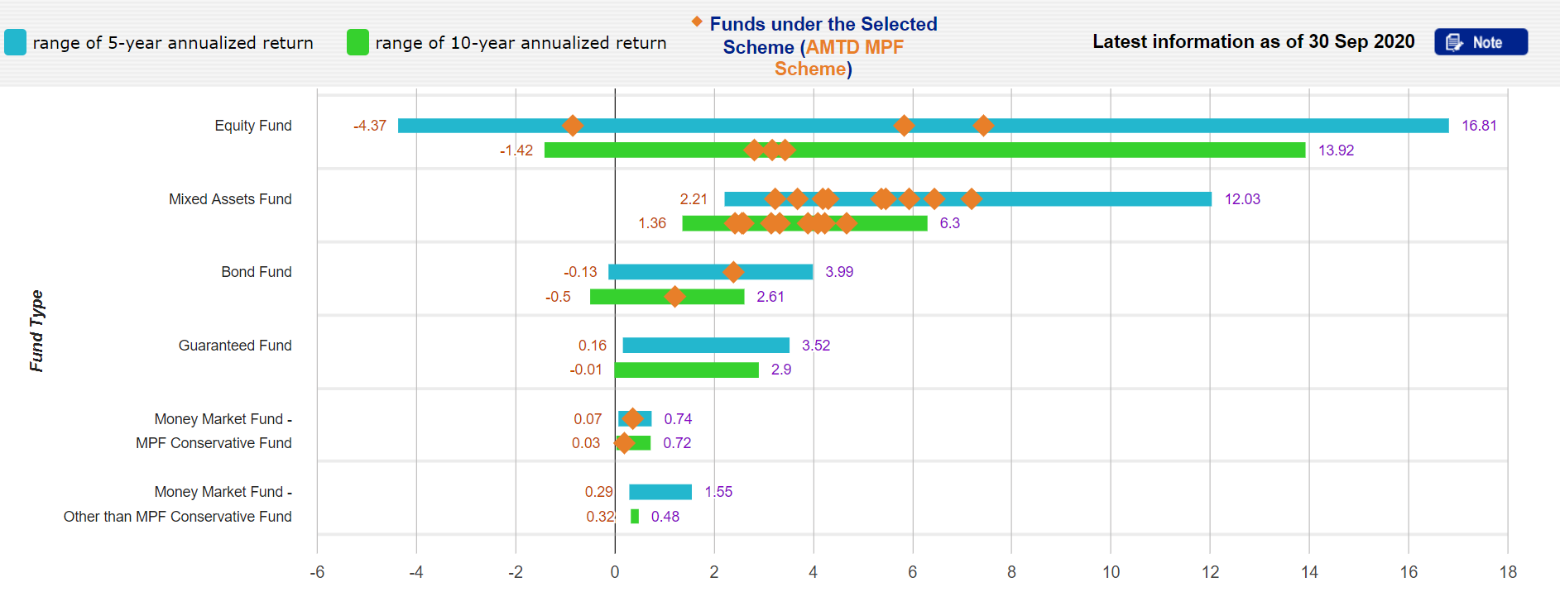
AMTD MPF Scheme

Slide 7
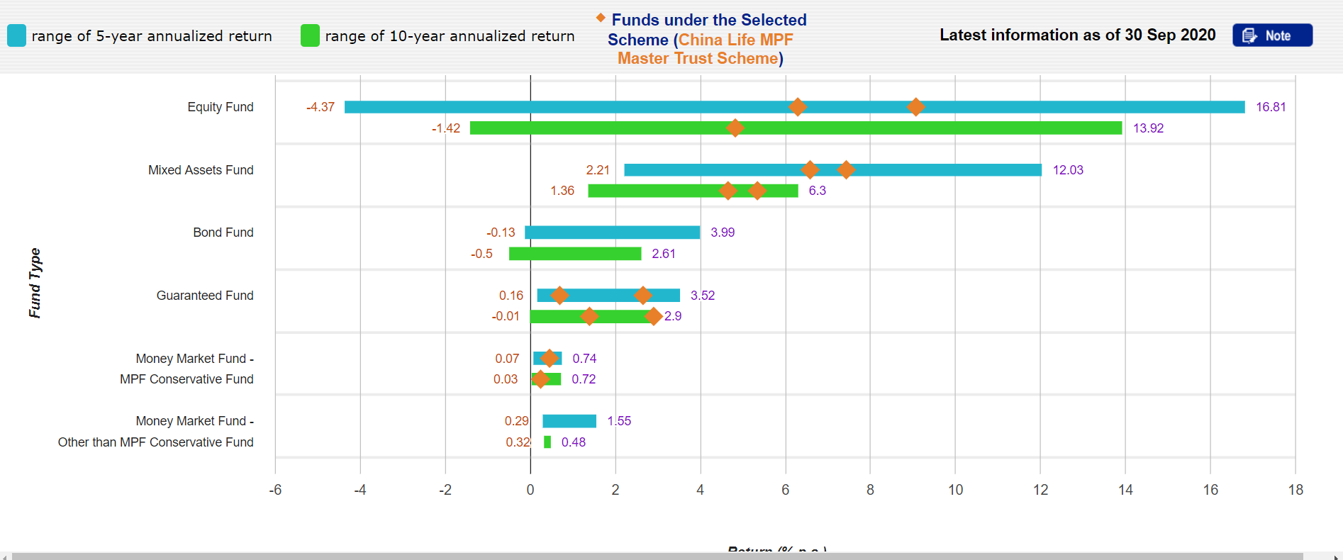
China Life MPF Master Trust Scheme

Slide 8
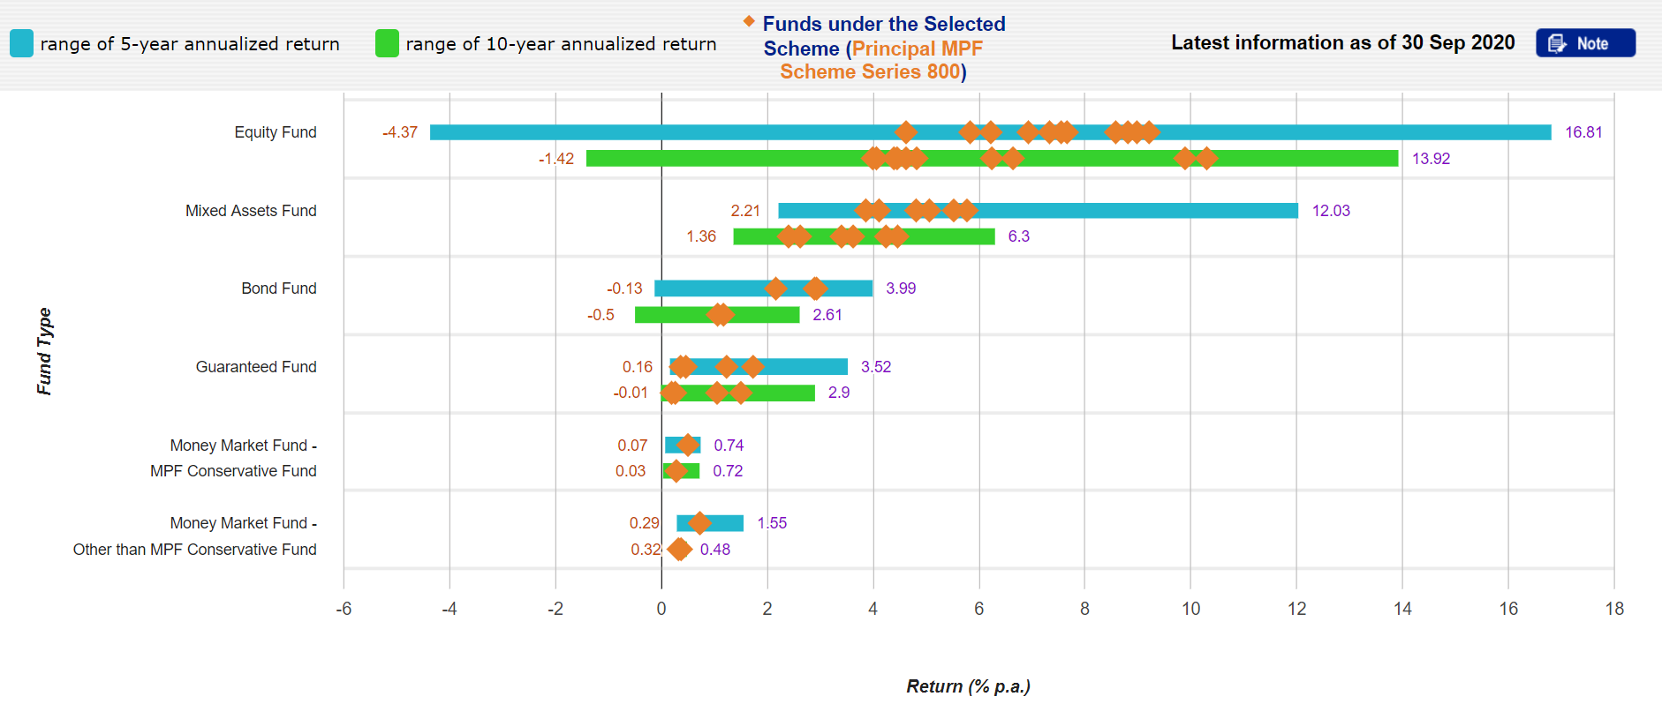
Principal MPF Scheme Series 800

Slide 9
Geography Target Group Risk Level

Slide 10
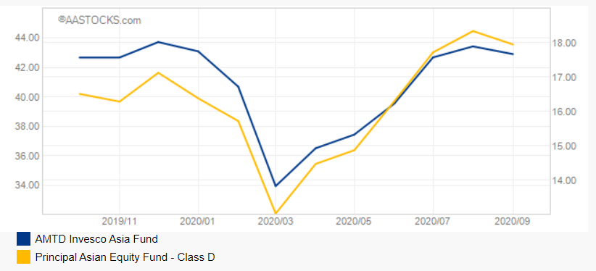
Example #1 - Asia

Slide 11
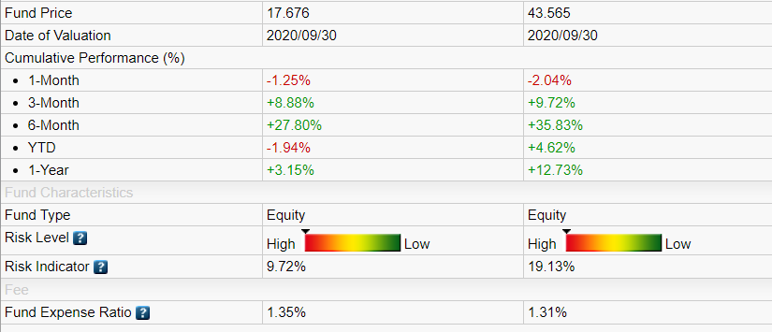
Example #1 - Asia

Slide 12
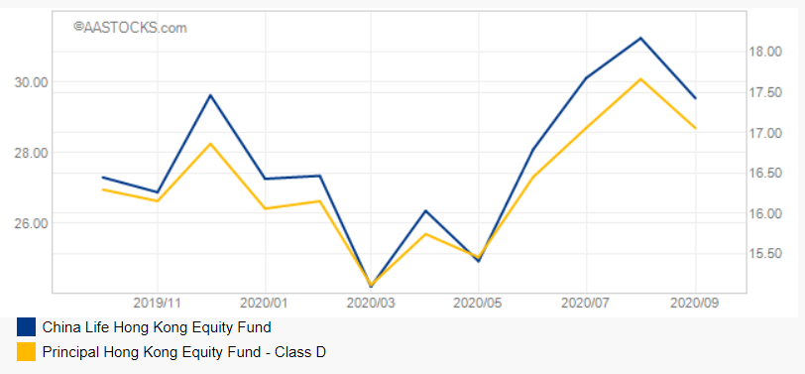
Example #2 – Hong Kong

Slide 13
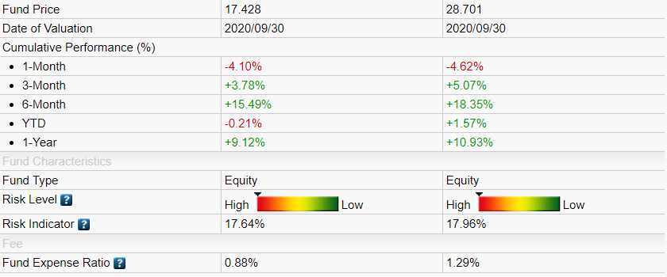
Example #2 – Hong Kong

Slide 14
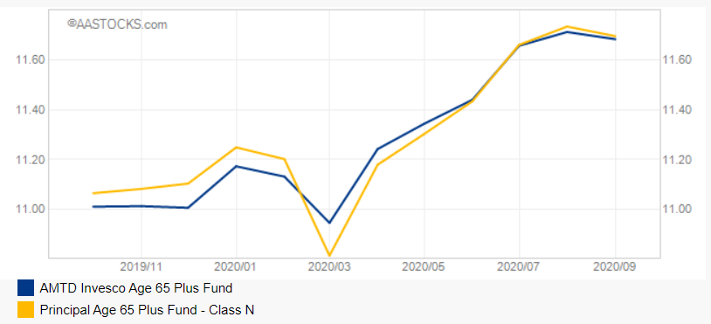
Example # 3 – 65 Plus

Slide 15
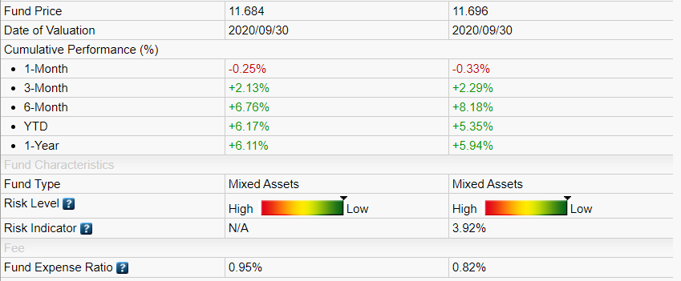
Example # 3 – 65 Plus

Slide 16
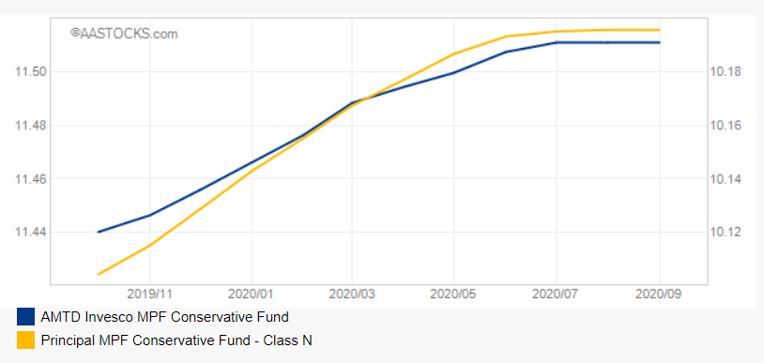
Example #4 - Conservative

Slide 17
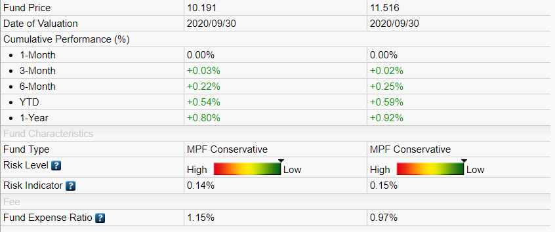
Example #4 - Conservative

Slide 18
2
Data Collection Method

Slide 19
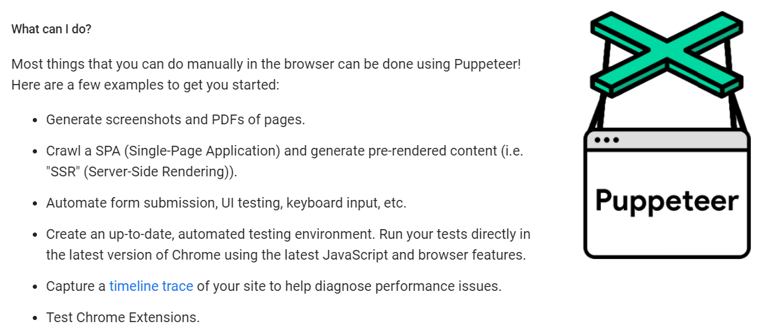
Sources & Collection of Data
1
2
3
Bloomberg Terminal
Mandatory Provident Fund Schemes Authority
Aastocks.Com Limited
Issuer Website
4

Slide 20
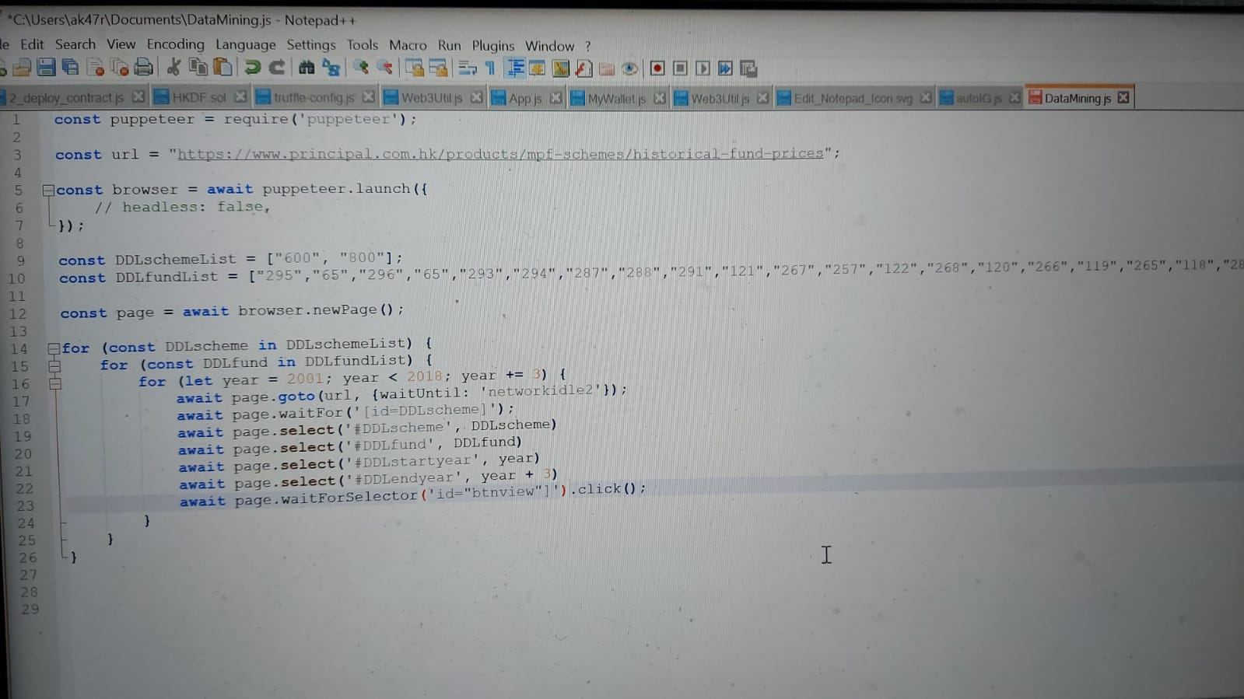
Sources & Collection of Data

Slide 21
Data profile of each MPF scheme
3

Slide 22
Data Profile
1. Raw Data
Historical Price
Daily
From Fund Start Date to Latest date
Fund size
Daily
From Fund Start Date to Latest date
-> Derive 10/20/50 days Moving Average, Variance, Return and hence Sharpe Ratio

Slide 23

AMTD Invesco MPF Conservative Fund

Slide 24

China Life MPF Conservative Fund

Slide 25

Principal MPF Conservative Fund

Slide 26
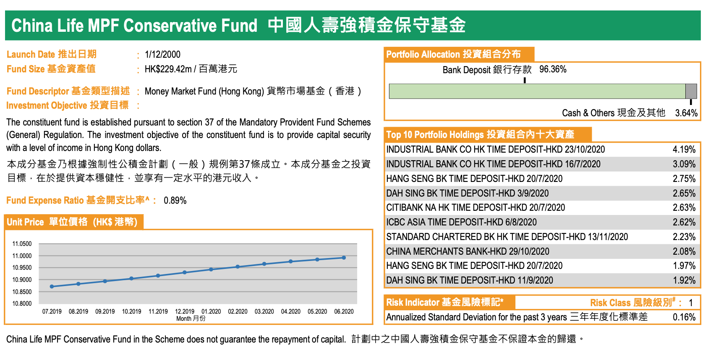
Data Profile
2. Fund Factsheet (PDF)
Portfolio Allocation
Portfolio Holdings

Slide 27
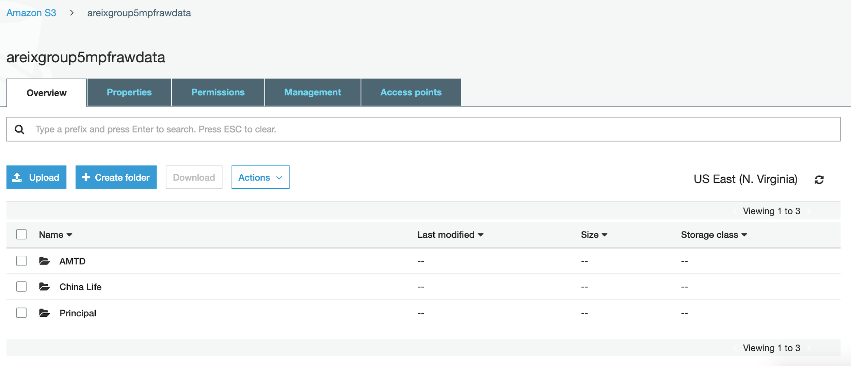
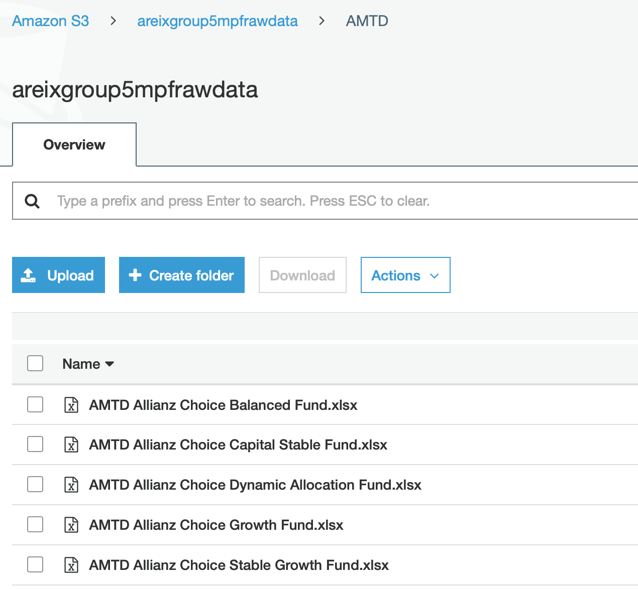
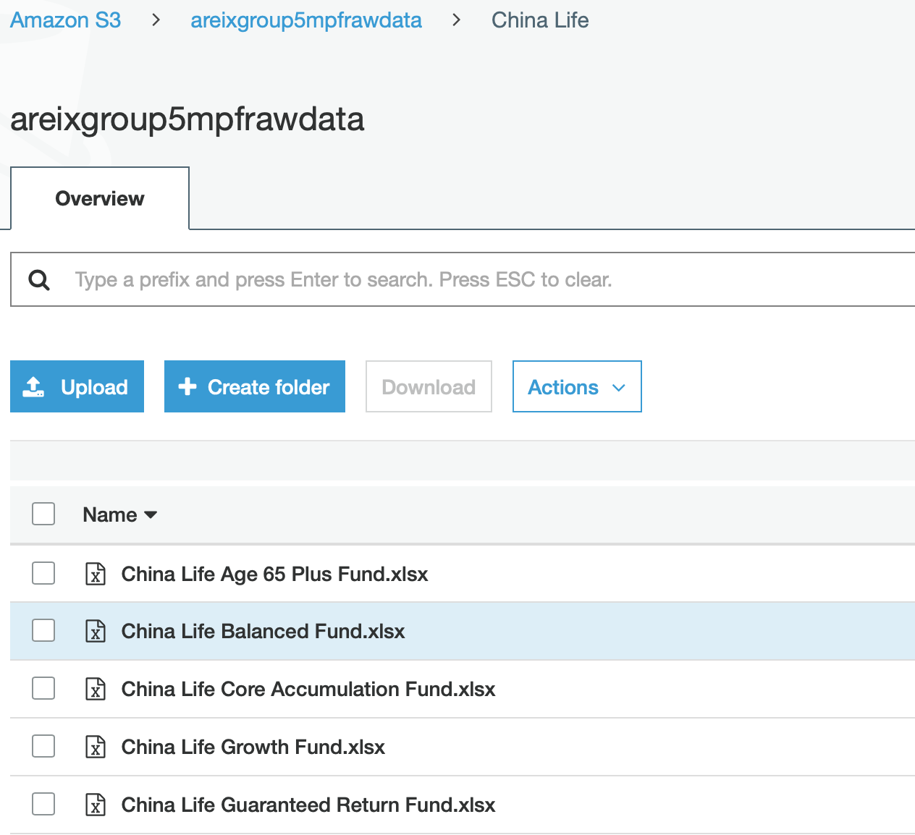
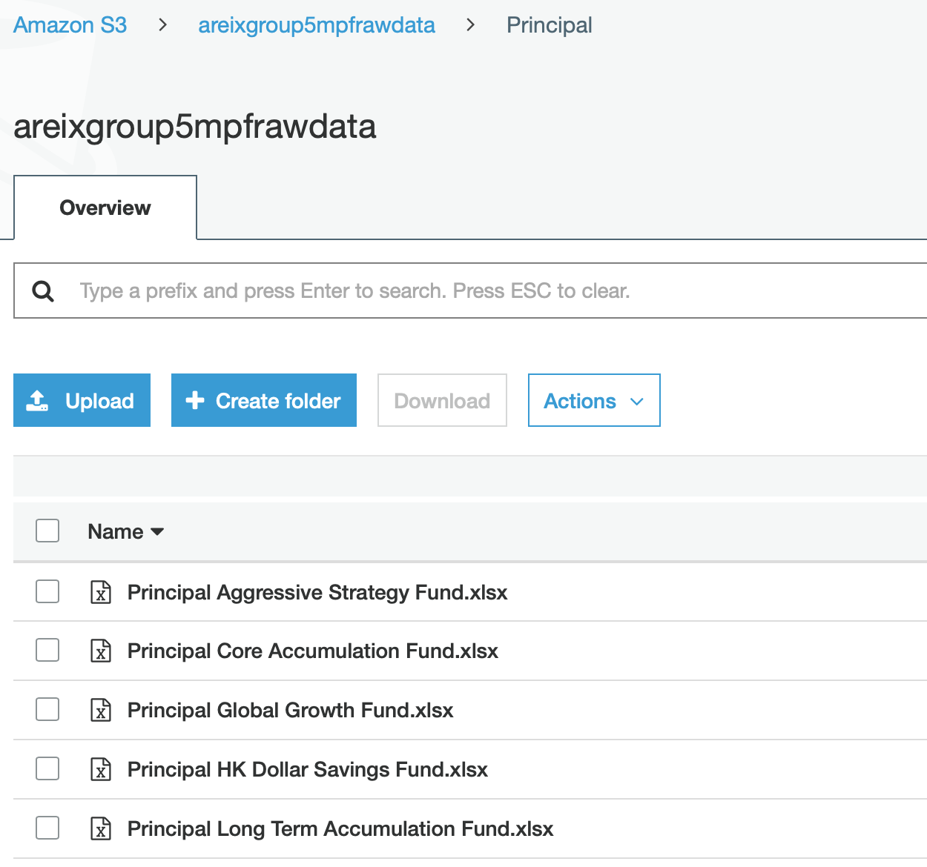
Storage
AWS Amazon S3
- Open bucket and share permission
- Each folder contain the respective company MPF scheme's funds historical price data

Slide 28
4
Data quality and handling

Slide 29
Dilemma – Conservative vs. Conservative

Slide 30

Dilemma – Principal vs. Principal

Slide 31
N/A DATA

Slide 32
Data Quality And Handling
TIME
EXTREME DATA
USE CLOSEST DATE WITHIN 1 COMPANY
REMOVE 2009 FINANCIAL CRISIS, COVID-19 RELATED DATA
PORTFOLIO DETAILS
N/A DATA
EMBED THE PDF INFO TO XLSX/CSV FOR MANIPULATION
USE THE LATEST AVAILABLE DATA IF DATA IS NOT AVAILABLE

Slide 33
5
Analytical-based table(s) (ABT)

Slide 34
Analytical-based table(s) (ABT)
Descriptive features
Date
Fund Size
Sharpe Ratio
Portfolio Info etc.
Target feature
Return
Volatility
Record = Instance -> Predictive Subject
Using Descriptive features
-> Find the correlation between Descriptive features with the Target features
-> Find the suitable fund to build the Portfolio

Slide 35
6
Modeling Discovery

Slide 36
Machine Learning
Supervised Learning - Algorithm
Classification
- Logistic Regression
- Random Forest
Regression
- Linear Regression
- Random Forest

Slide 37
Logistic & Linear Regression
Limitations:
If the number of observations is lesser than the number of features, Logistic & Linear Regression should not be used, otherwise, it may lead to overfitting.
It constructs linear boundaries.
The major limitation of Logistic & Linear Regression is the assumption of linearity between the dependent variable and the independent variables.
It can only be used to predict discrete functions. Hence, the dependent variable of Logistic & Linear Regression is bound to the discrete number set.
Non-linear problems can’t be solved with Logistic & Linear regression because it has a linear decision surface. Linearly separable data is rarely found in real-world scenarios.

Slide 38
Random Forest
Advantages:
Random Forest is based on the bagging algorithm and uses Ensemble Learning technique. It creates as many trees on the subset of the data and combines the output of all the trees. In this way it reduces overfitting problem in decision trees and also reduces the variance and therefore improves the accuracy.
Random Forest can be used to solve both classification as well as regression problems.
No feature scaling required: No feature scaling (standardization and normalization) required in case of Random Forest as it uses rule based approach instead of distance calculation.
Handles non-linear parameters efficiently: Non linear parameters don't affect the performance of a Random Forest unlike curve based algorithms. So, if there is high non-linearity between the independent variables, Random Forest may outperform as compared to other curve based algorithms.
Random Forest is usually robust to outliers and can handle them automatically.

Slide 39
Thanks!
Please keep this slide for attribution.

